Slide 1
Moffat Bay Lodge
CSD-460
Bravo Team
5/6/26

Slide 2
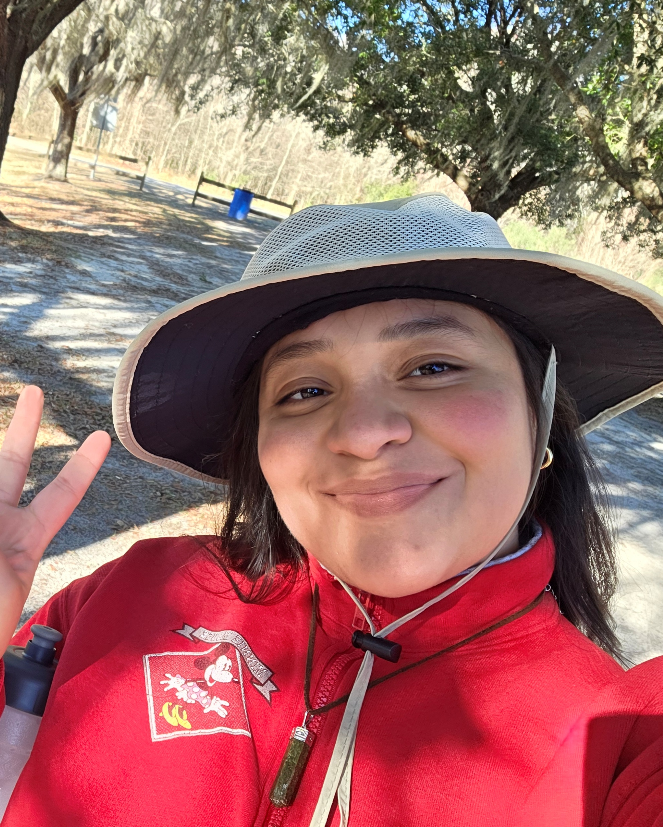
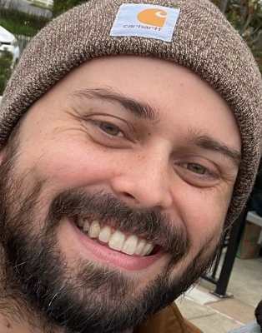
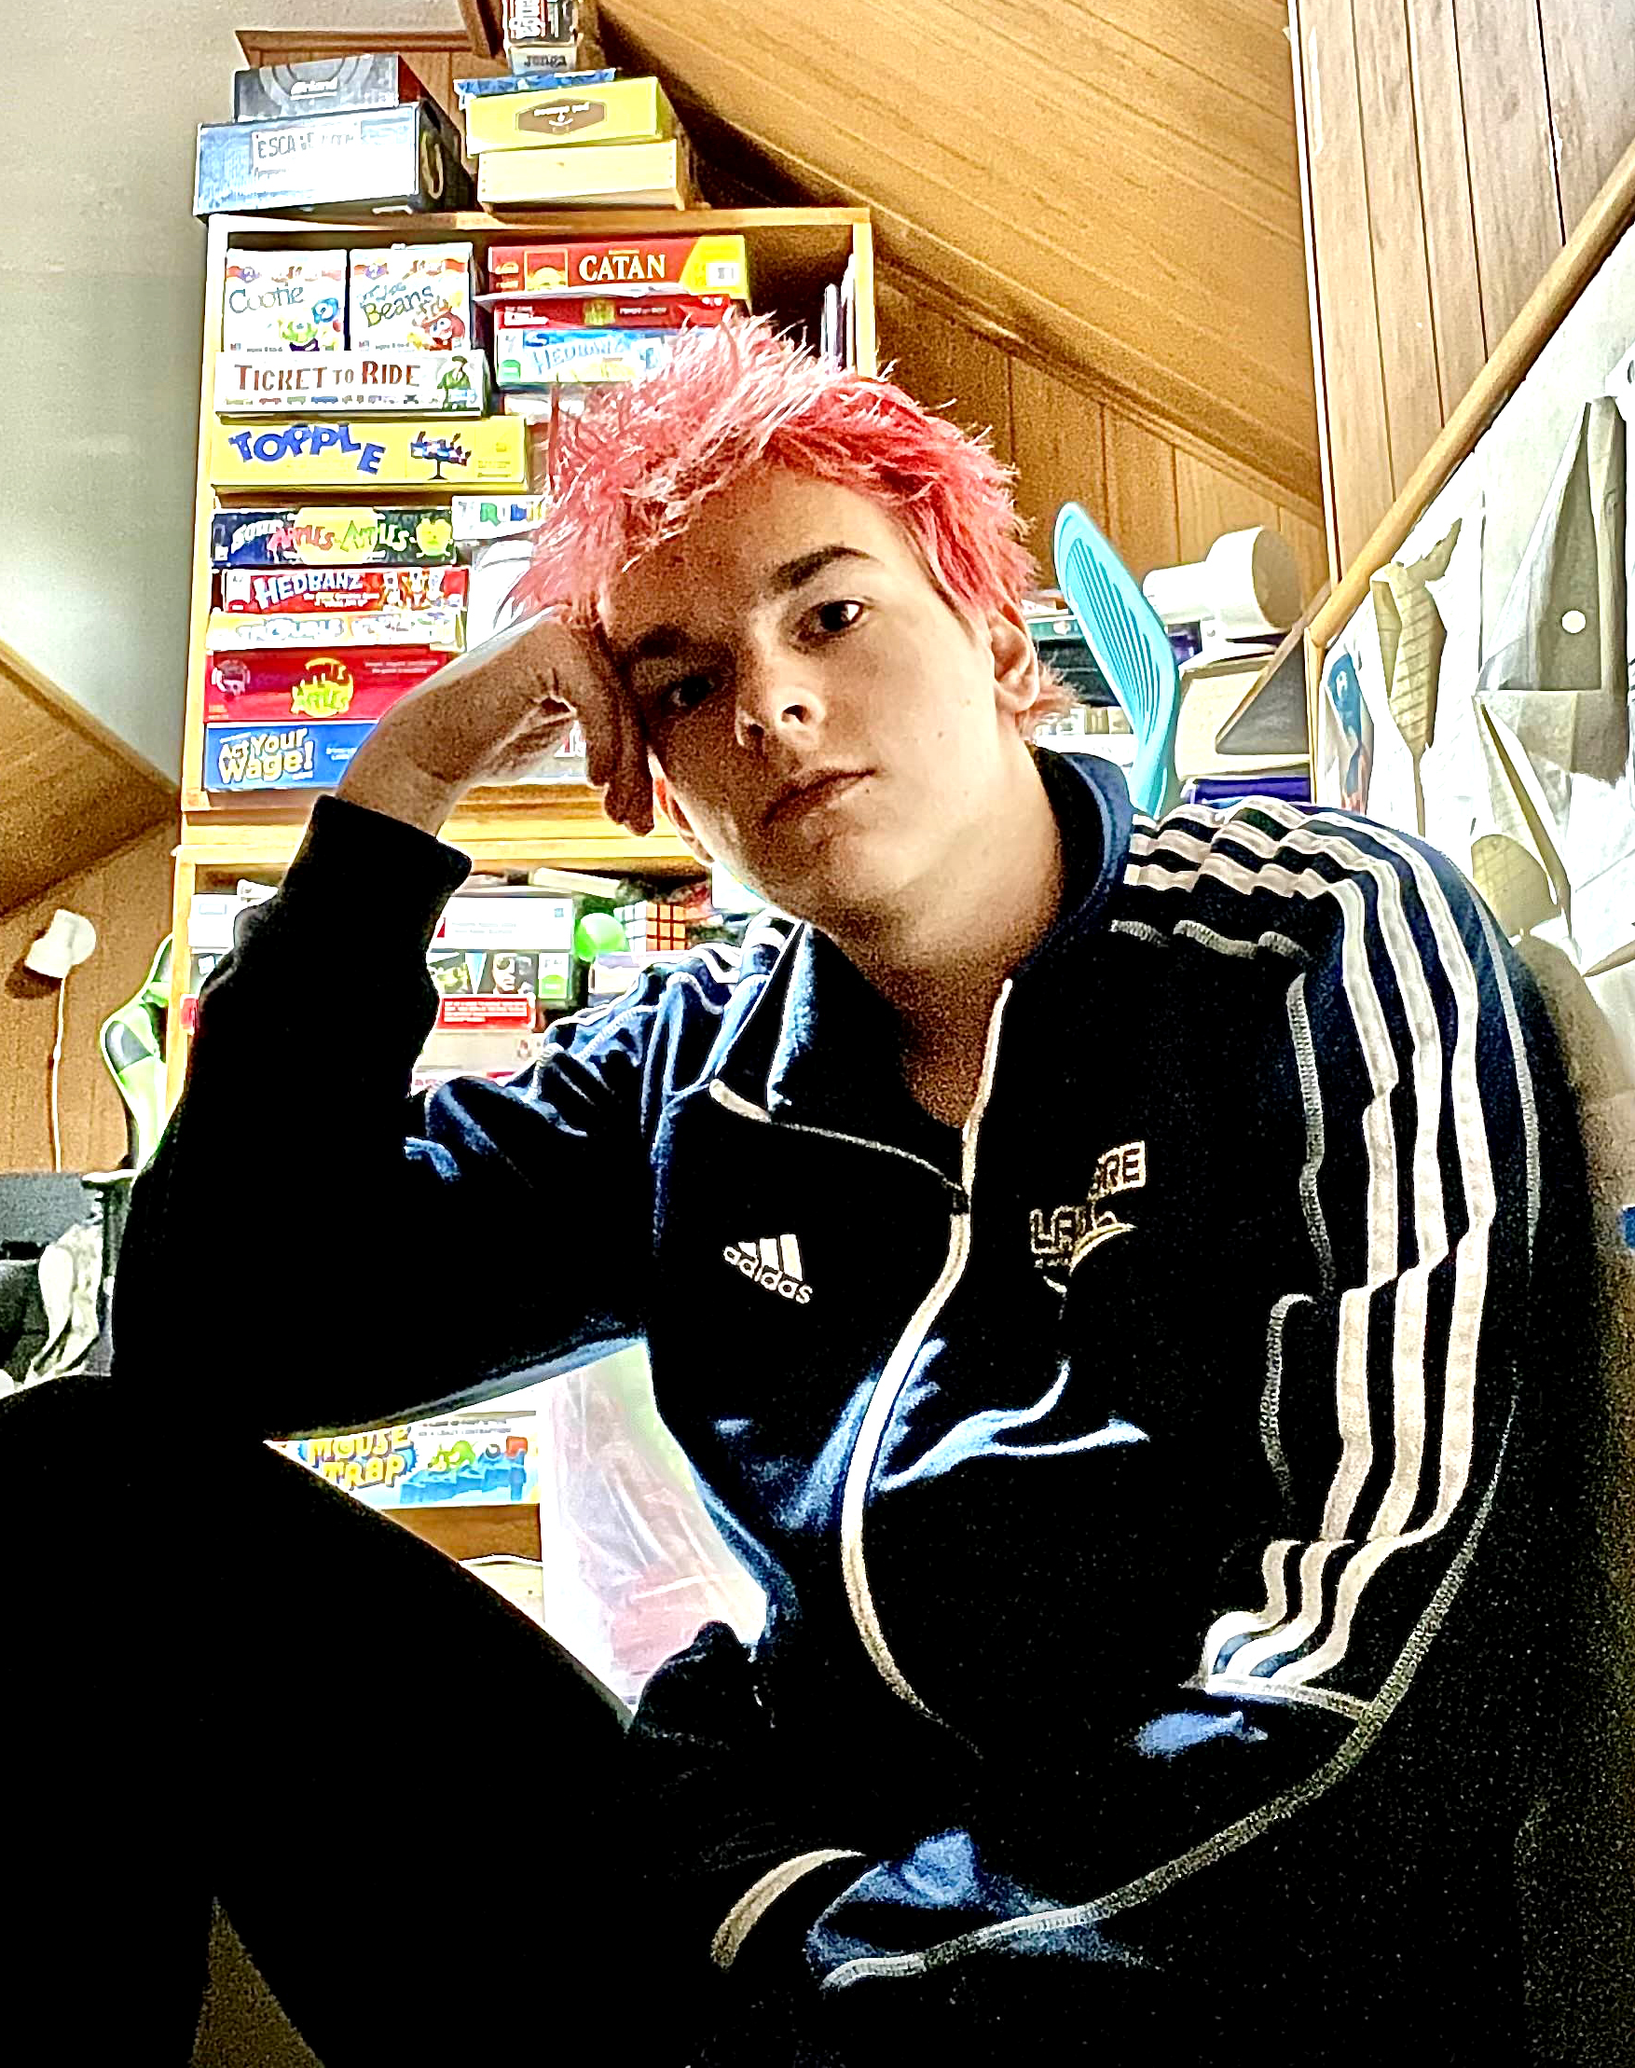
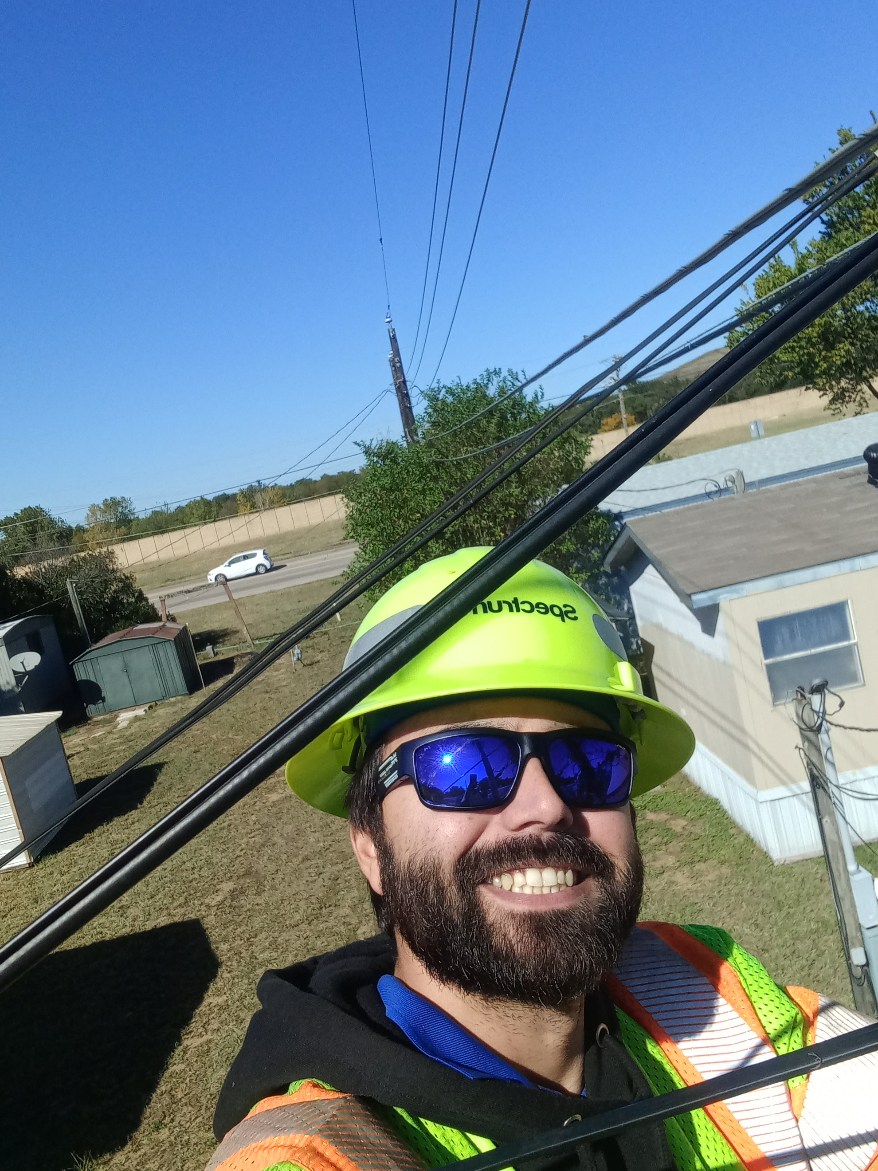
Meet the Team
Angela Vargas
Zachary Anderson
Tevyah Hanley
Cameron Mendez

Slide 3
About us
Angela Vargas is a software development student based in Loveland, Colorado, currently working as a Micromaintenece Tech for Target. She has experience with IT and in computer mechanics.
Tevyah Hanley is a software development student based in Columbus, Ohio, currently working in IT. He is building experience in both frontend and backend development.
Cameron Mendez is a software development student based in Fort Worth, Texas, currently working in FO Network Design. Developing hands on experience in all aspects of the software development lifecycle.
Zachary is a software development student based in Modesto,California. He currently is working outside of the IT profession but hopes witha degree in the field to transfer into it. The experience from this program has been incredibly beneficial to his skills.

Slide 4
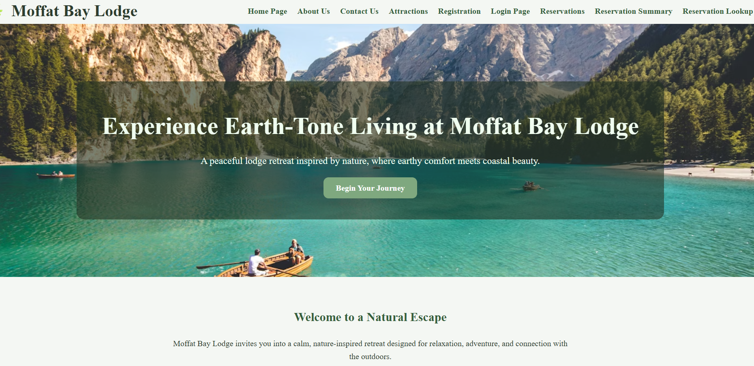
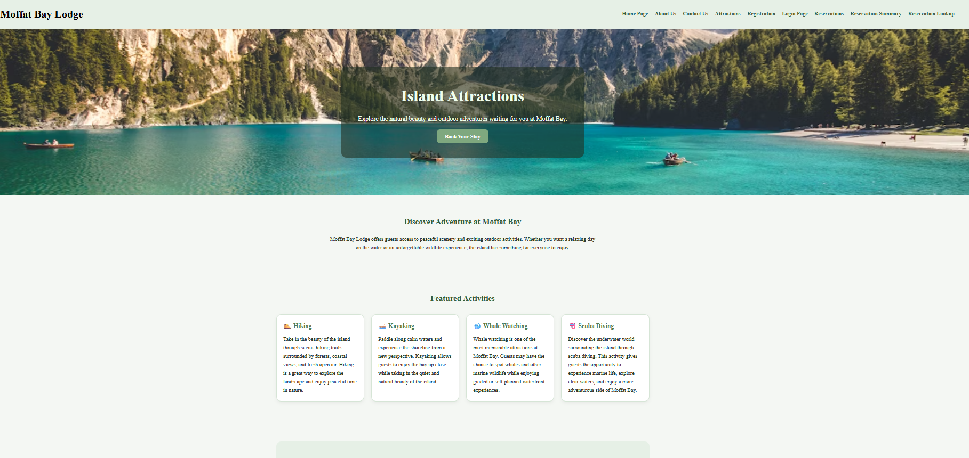
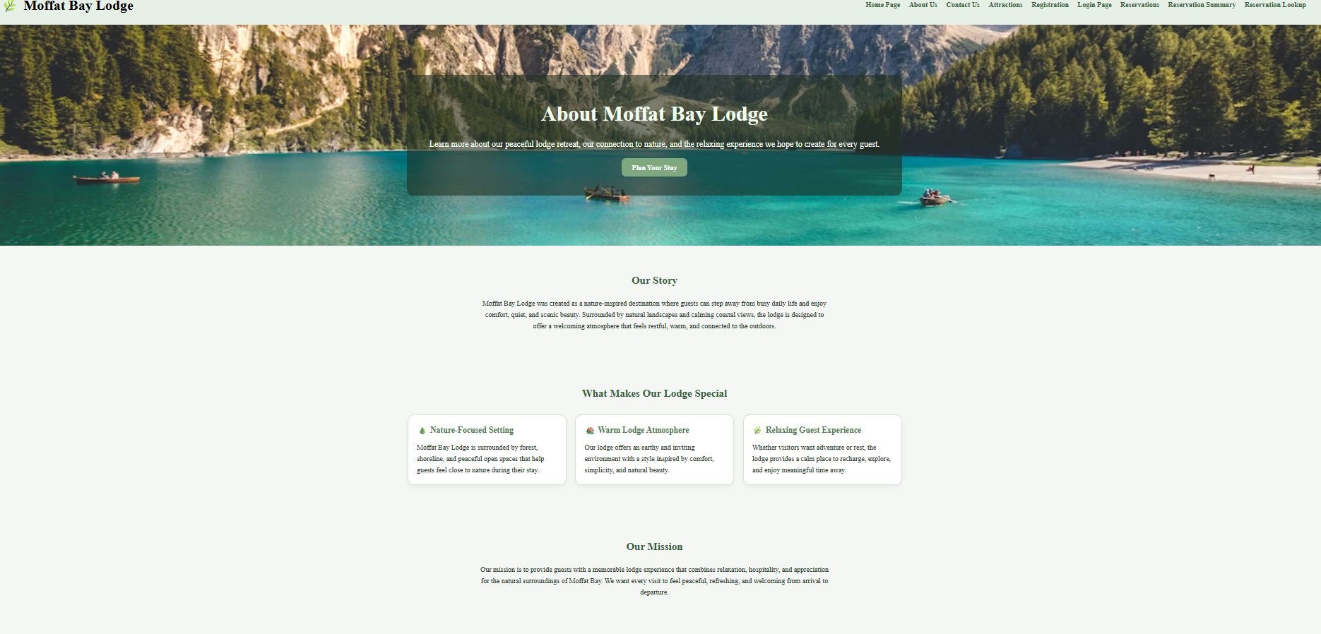
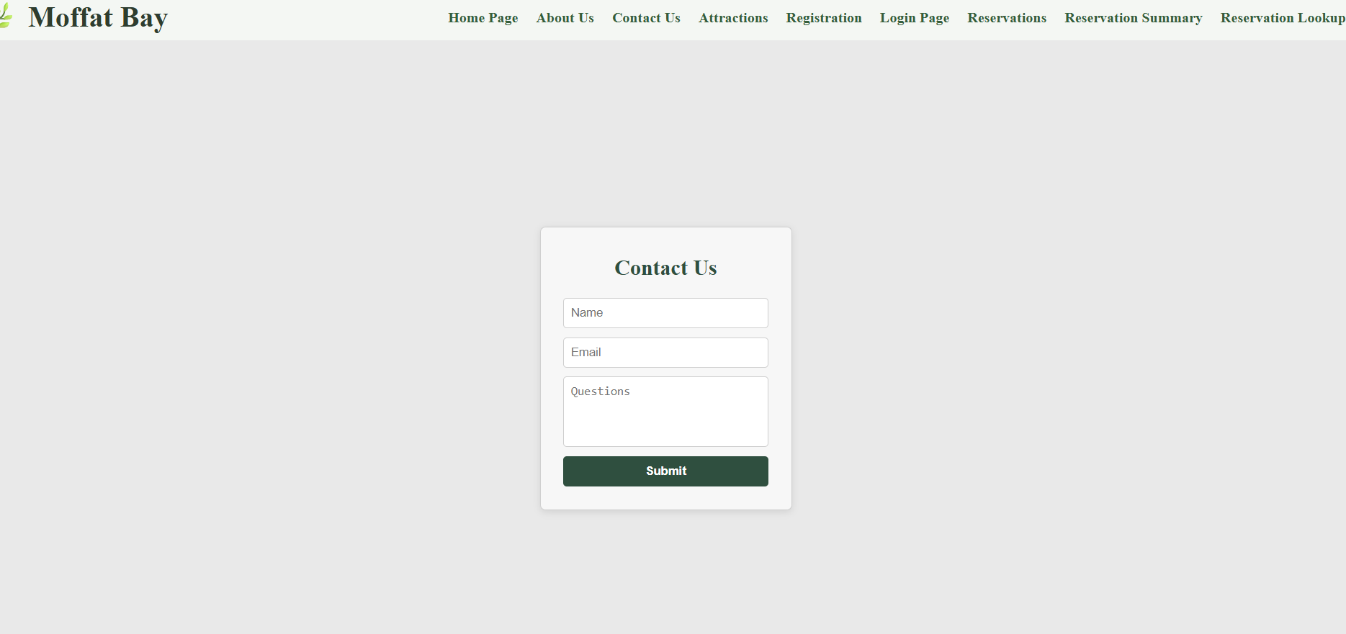
Sample Prototype
Landing
About Us
Attractions
Contact Us

Slide 5
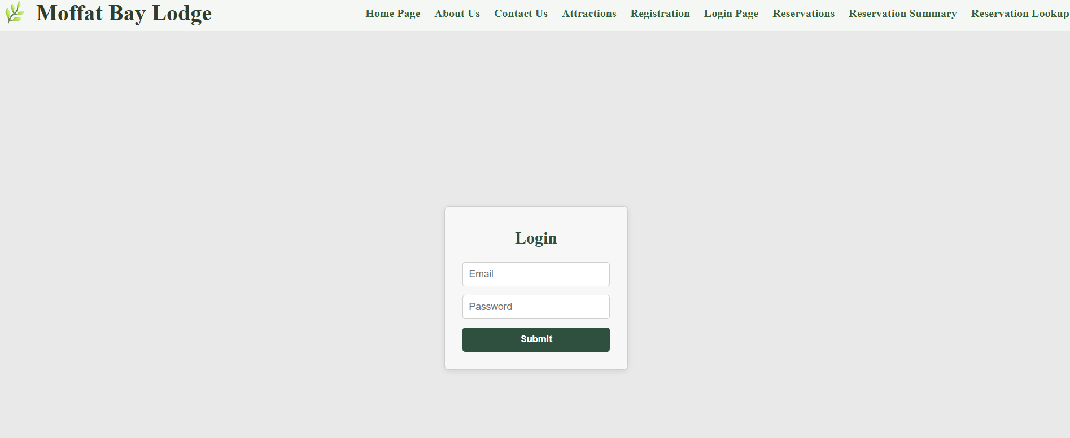
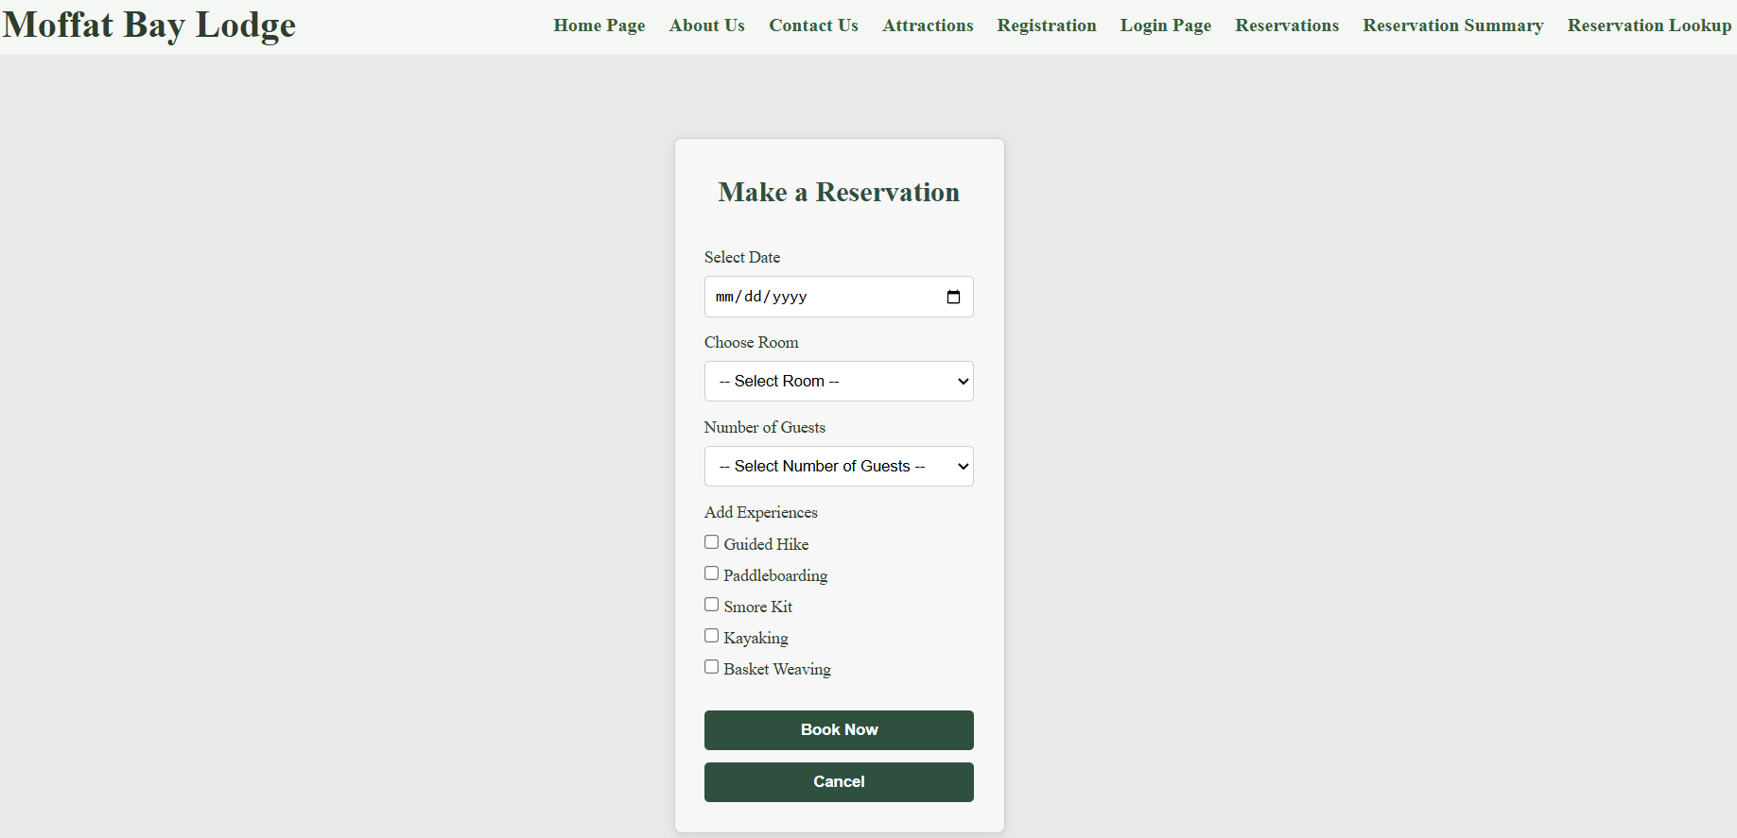
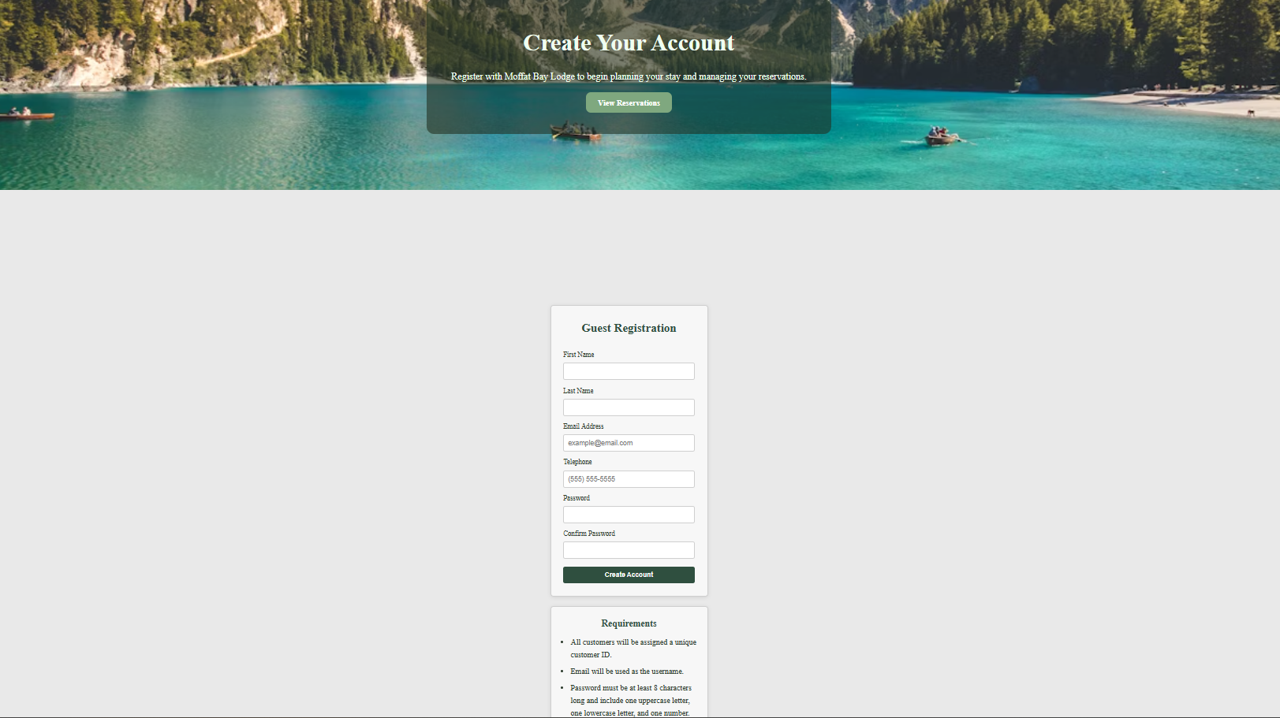
Sample Prototype cont.
Login
Registration
Reservation

Slide 6
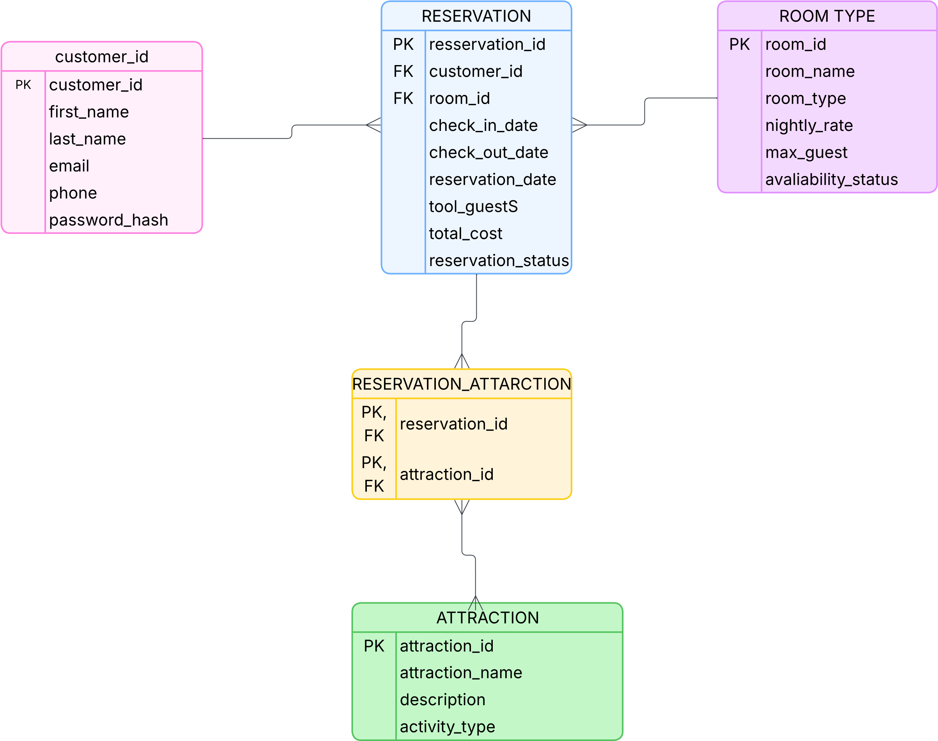
ERD

Slide 7
Test Cases #1 & #2
Successful Reservation
Peer Tester – Cameron Mendez
Dev. –Zachary Anderson
Successful Reservation w/ Attractions
Peer Tester – Cameron Mendez
Dev. Zachary Anderson
This is a major part of the full site. Testing this feature involved making sure the page opened, buttons worked, and even that the database interacted with it. We started by opening the page (ensuring we are logged in) and filling out the form. When the reservation is made, we can then check the database to make sure that the reservation shows up.
This feature is an important part of the reservation system because it allows users to add attractions to their stay. Testing this feature involved making sure the page loaded correctly, the attraction options displayed properly, and the form submitted successfully. We began by opening the page while logged in, selecting attractions along with reservation details, and submitting the form. After the reservation was completed, we checked the database to confirm that both the reservation and selected attractions were stored correctly.

Slide 8
Test #3 & #4
Login Required for Reservation
Peer Tester – Zachary Anderson
Dev. –Angela Vargas
About Us Page
Peer Tester – Zachary Anderson
Dev. –Angela Vargas
This test verifies that users must be logged in before accessing the reservation page. Testing involved opening the reservation page without logging in, attempting to access it directly through the URL, and confirming the system redirected the user to the login page. After logging in with valid credentials, the reservation page loaded successfully and the active session displayed the username in the navigation bar. The test passed because access was restricted until login was completed.
This test verifies that the About Us page loads correctly and displays the expected content. Testing involved navigating to the About Us page, checking that the story, mission, and team sections appeared, and confirming the page worked with active session data. After logging in, the welcome message displayed with the username. After logging out, the welcome message no longer appeared. The test passed because the page displayed properly and session handling worked correctly.

Slide 9
Test #5
“Book Your Stay” Button Navigation
Peer Tester – Zachary Anderson
Dev. –Angela Vargas
This test verifies that the “Book Your Stay” button on the Attractions page correctly redirects users to the reservation page. Testing involved navigating to the Attractions page and confirming that all page content, images, and activity information loaded properly. After selecting the “Book Your Stay” button, users were successfully redirected to the Reservations page after logging in. The test passed because the button navigation worked correctly and all page elements displayed clearly without formatting issues.

Slide 10
Lessons Learned- Bravo Team
Angela Vargas
Working on the Moffat Bay Lodge project was an enjoyable experience because it gave our team the opportunity to create a fully functional website while learning more about web development and teamwork. One of the biggest lessons learned during this project was the importance of communication and organization when working in a group environment. Since each team member had different schedules and responsibilities, it was important to make sure everyone stayed on the same page throughout the development process.
As the project continued, our team improved communication by regularly discussing which sections each person was responsible for and updating one another when tasks were completed. This helped prevent confusion and allowed the project to move forward more smoothly. We also learned the importance of planning ahead and creating a game plan at the beginning of each week so every team member understood the goals and deadlines for upcoming assignments.
Overall, this project helped strengthen our teamwork, collaboration, and problem-solving skills while also giving us hands-on experience with PHP, MySQL, GitHub, testing, and website development.

Slide 11
Lessons Learned- Bravo Team cont.
Zachary Anderson
This project was a look into the future of software development, and I was here for every second of it. My team was wonderful, and I learned a lot from our successes and mistakes. Some of the troubles we had were scheduling conflicts, internet connection issues due to storm outages, and misreading assignment requirements. These were overcome because all our members would pick up the others who were faltering when needed. That was a look at what a good software development team could do. We were just students at the time, but it felt like we were working for a client. I liked that aspect a lot.

Slide 12
Lessons Learned- Bravo Team cont.
Cameron Mendez
One of the biggest lessons learned during the Moffat Bay project was how small formatting and coding issues can create larger problems throughout a website. Our team experienced challenges with page layouts, file organization, and making sure code changes worked correctly across different sections of the project. These situations showed how important attention to detail and communication are in web development. In real-world software projects or not, even minor formatting mistakes, inconsistent code, or failure to follow company standards can affect the user experience and slow down development if teams are not organized. Altogether, I think this project helped us improve our teamwork, problem-solving, and understanding of how collaborative web development works in a professional environment.

Slide 13
Lessons Learned- Bravo Team cont.
Tevyah Hanley
I would say the biggest thing I learned was how security and passwords work in sites. I had basic familiarity in databases, but as someone who worked heavily on the login and account creation aspect of the site, I realized that it’s a bit more complicated than I first thought it would be. Making sure that everything is hashed, all the tables are aligned and pushing and pulling from the right parts and then displaying that quickly and effectively to the user was overall a tough challenge, but I think it looks really smooth now and I am glad I was hands on in that part. Also working with a team outside of a face-to-face team interaction was a really great experience as well, getting to see how we all tackled issues with very different schedules, we all seemed to make it work and come out with a great final project.

